Slide 1
Data Structures and Algorithms

Slide 2
What is Data Structures and Algorithms?
Data is information that is being stored in a computer in form of 0’s and 1’s. Structures is the way of organizing. Data Structure is way to store and organize data.
Algorithms are the collection of steps to solve the particular problem.
Example: Books arrangement in your home shelf vs Books arrangement in your university library.
Why to learn?
It helps computer programer to write optimize and efficient codes.
It also prepare you to crack the interview questions of big tech companies.

Slide 3
Most Common Data Structure
Array
String
Linked List
Dictionaries/ Hashmap
Stacks and Queues
Trees
Graphs
Heep

Slide 4
Most Common Coding Algorithms
Brute Force Algorithm.
Recursive Algorithm.
Divide and Conquer Algorithm.
Binary Search.
Merge Sort.
Quick Sort.
Sorting Algorithm
Bubble Sort.
Insertion Sort.
Merge, Selection, Quick Sort
Dynamic Programming Algorithm.
Greedy Algorithm.
Backtracking Algorithm

Slide 5
Week 1- Content
What is an array ?
Time complexity/ Cost
Basic properties of Arrays.
Implementing basic Array operations.

Slide 6
What is array?
An Array is the collection of items of same data type (integer, float, boolean, string).
The item can be store in neighboring (contiguous) memory locations.
It can hold upto N items.
Notes:
The Array can only hold up to 15 DVDs. If we get a 16th DVD, we'll need to make a new Array.Well, the reason is the same as it is for the physical box of DVDs. Do you really want to find a box that could hold 1000000 DVDs when you currently only have 15 DVDs and, in fact, never expect to own more than 100 of them?

Slide 7
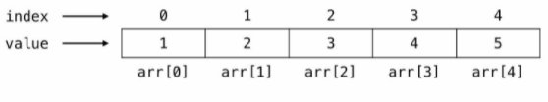
Accessing the element of the array.
Each of the places is identified using a number in the range of 0 to N - 1.These numbers that identify each place indexes.

Slide 8
Array capacity vs Array length
Number of elements array can hold is called capacity of array.
Like
int arr[6]={1, 2, 3, 4, 5, 6}
int arr[]={1, 2, 3, 4, 5, 6} or arr=[1, 2, 3, 4, 5, 6]
Number of elements currently in array is called length of array.
Length of array= len(arr)
Notes:
Is it a valid operation to insert an element at array[6]? What about at array[10]?

Slide 9
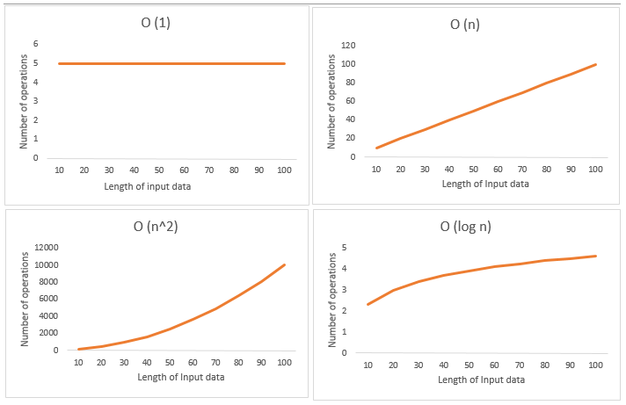
Time Complexity | Big O Notation
Notes:
Time complexity is the amount of time taken by an algorithm to run, as a function of the length of the input. It measures the time taken to execute each statement of code in an algorithm.
For Big O Notation see this link https://towardsdatascience.com/introduction-to-big-o-notation-820d2e25d3fd

Slide 10
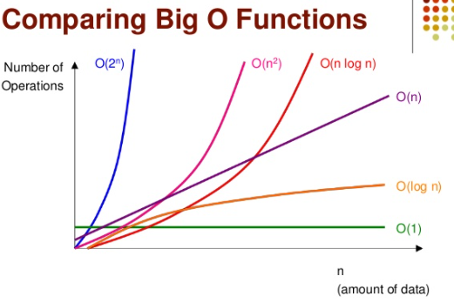
Time Complexity
Notes:
The space complexity of an algorithm or a computer program is the amount of memory space required to solve an instance of the computational problem as a function of characteristics of the input. It is the memory required by an algorithm until it executes completely.

Slide 11
Basic Array Operations
Insertion
Deletion
Search

Slide 12
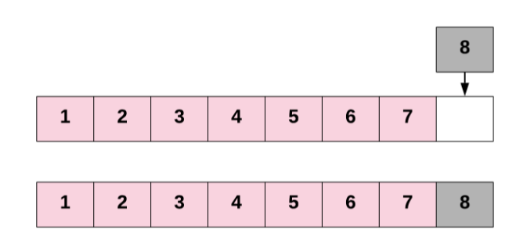
Array Insertion
Inserting a new element into an Array can take many forms:
Inserting a new element at the end of the Array. O(1)

Slide 13
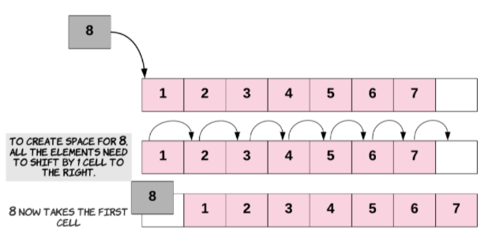
Array Insertion
2. Inserting a new element at the beginning of the Array. O(n)

Slide 14
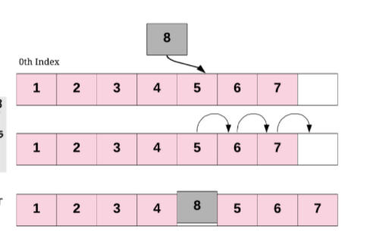
Array Insertion
3. Inserting a new element at any given index inside the Array. O(n)

Slide 15
Array Deletion
Deleting the last element of the Array.
Deleting the first element of the Array.
Deletion at any given index.

Slide 16
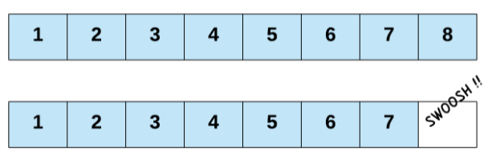
Array Deletion
2. Deleting the last element of the Array.

Slide 17
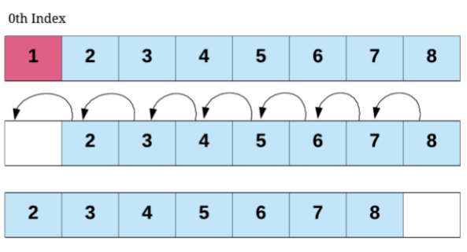
Array Deletion
Deleting the first element of the Array.

Slide 18
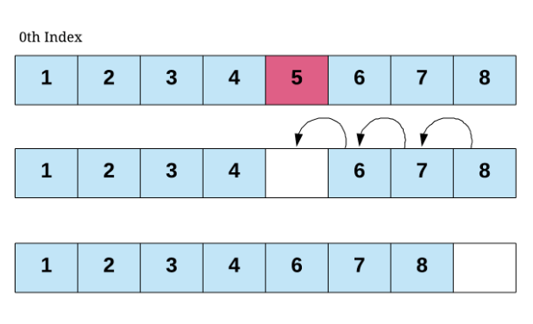
Array Deletion
3. Deletion at any given index.

Slide 19
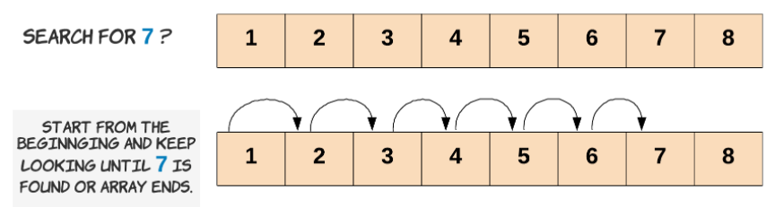
Array Search

Slide 20
Week 2- Contents
What is Strings?
Basic string operations and its implemention
LeetCode problems

Slide 21
String
Strings are arrays of bytes representing Unicode characters.
Python does not have a character data type, a single character is simply a string with a length of 1.
Creating a String
Strings in Python can be created using single quotes or double quotes or even triple quotes.

Slide 22
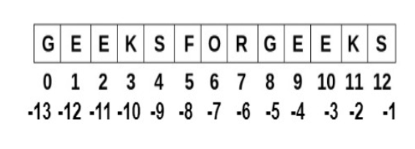
Basic String Operation
Accessing characters in Python
String can be accessed by using the method of Indexing
“GEEKSFORGEEKS”

Slide 23
Basic String Operations
1- Creating a string
2-Accessing Element in the string
3-String Slicing
4-Methods for strings

Slide 24
Linked list

Slide 25
CONTENTS
What is Linked list?
Types of Linked list
Linked list Operations
Comparison of Array and Linked list Time Complexities
Implementation

Slide 26

What is Linked list?
Its linear data structure, just like array.
Nodes (Data/ Value + Reference/Address of next node value)
First node == Head
Last node == Null
Each element in the linked list actually seperate object, while all the objects are linked together by the reference field in each element.

Slide 27


Types of Linked list
Singly linked list.
Doubly linked list.

Slide 28
Singly Linked list Operations
Accessing the element/ data.
Insertion.
Deletion.

Slide 29
Accessing the element-Singly Linked list
In array accessing element is in constant time O(1).
In Linked list if we want access the ith element, we want to traverse the head node one by one.
It take linear time O(N). where, N is length of linked list.
Notes:
For instance, in the example above, the head is the node 23. The only way to visit the 3rd node is to use the "next" field of the head node to get to the 2nd node (node 6); Then with the "next" field of node 6, we are able to visit the 3rd node.

Slide 30

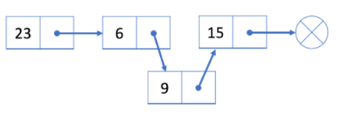
Insertion -Singly Linked list
Insert a new node into a linked list in O(1) time complexity.

Slide 31


Insertion -Singly Linked list
Notes:
We initialize a new node 9 and link node 9 to current head node 23.
Assign node 9 to be our new head.
Use similar strategy for adding node at the end of linked list.

Slide 32


Deletion - Singly Linked list
Notes:
1-Find cur's previous node prev and its next node next.
2-Link prev to cur's next node next
In our first step, we need to find out prev and next. It is easy to find out next using the reference field of cur. However, we have to traverse the linked list from the head node to find out prev which will take O(N) time on average, where N is the length of the linked list. So the time complexity of deleting a node will be O(N).
The space complexity is O(1) because we only need constant space to store our pointers.
Let's try to delete node 6 from the singly linked list above.
1. Traverse the linked list from the head until we find the previous node prev which is node 23
2. Link prev (node 23) with next (node 15)

Slide 33


Deletion - Singly Linked list
Notes:
If we want to delete the first node, the strategy will be a little different.
As we mentioned before, we use the head node head to represent a linked list. Our head is the black node 23 in the example below.
If we want to delete the first node, we can simply assign the next node to head. That is to say, our head will be node 6 after deletion.

Slide 34

Accessing- Doubly Linked list
Notes:
We are not able to access a random position in constant time.
We have to traverse from the head to get the i-th node we want.
The time complexity in the worse case will be O(N), where N is the length of the linked list.

Slide 35
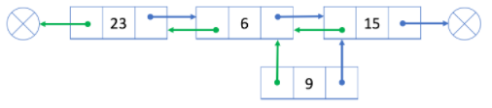
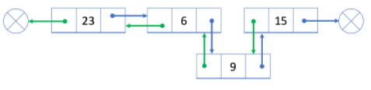
Insertion- Doubly Linked list

Slide 36

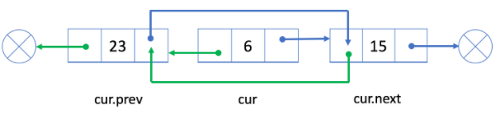
deletion- Doubly Linked list

Slide 37
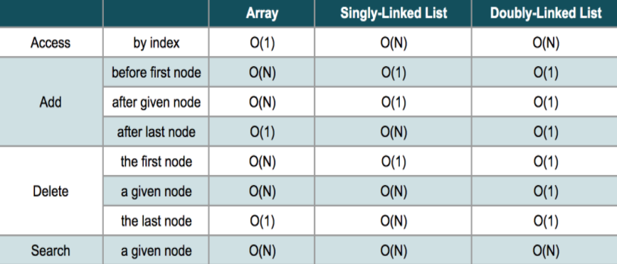

Slide 38
Stacks & Queues

Slide 39
Week 04- Contents
What is stack and queue?
Implementation:
- Using list as a stack in Python
- Using deque as a stack in Python

Slide 40
Stacks
A stack is a data structure that stores items in an Last-In/First-Out manner. This is frequently referred to as LIFO.
Use cases:
visiting different pages on a web page.
the Undo feature in your editor.
A queue is similar to a stack, except that (much like a real queue/line), it follows a "First-In-First-Out" (FIFO) model
Placing the order in a restaurant.

Slide 41

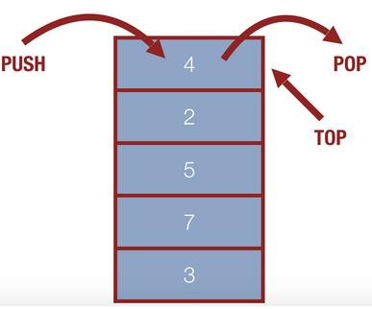
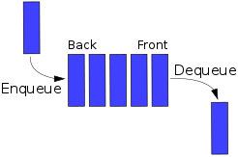

Slide 42
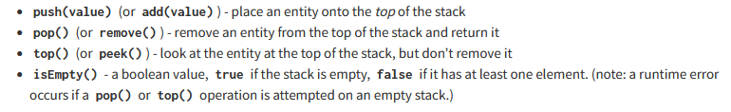
Operations on Stacks

Slide 43
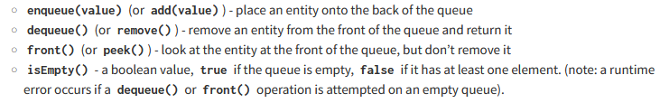
Operations on Queues

Slide 44
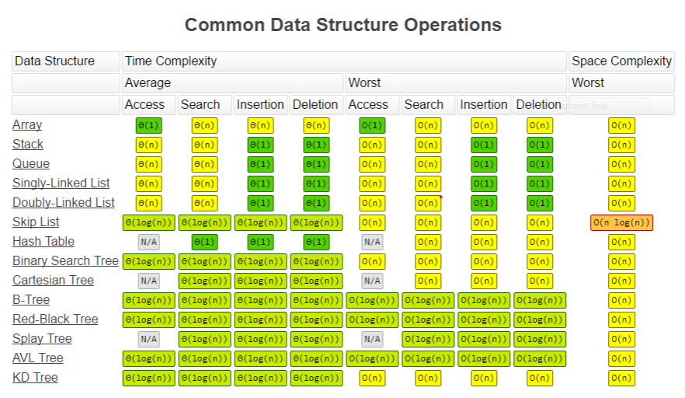

Slide 45
Binary Tree

Slide 46
Week 05- Content
What is TREE Data Structure?
When to use?
Tree TRAVERSAL
DFS & BFS
Implementation in Python

Slide 47

TREES
Hierarchical Data Structure
Examples:
- Family Tree.
- Any organization Admin Structure

Slide 48

TREES

Slide 49

TREE
Root, Branch, Leaves
GP
Root Node
Branches
C
C
Leaves
GC
GC
GC
GC
GC

Slide 50
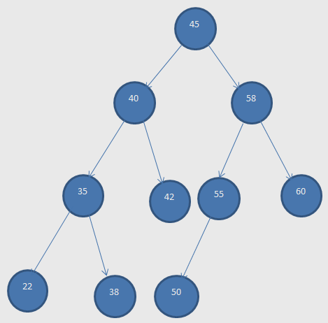
BINARY TREE
Every node at max two child node / max two branches
Terms USED for TREE:
Root/ Parent Node, Left Child, Right Child .
Sibling Node (Nodes having same parent node).
Leaf (end node)
Ancestors ( no of all parent nodes )
LEVEL & SUBTREE:
45 (level 1 & Depth 1), (40, 58) (level 2 & depth 2)
Left subtree & Right subtree

Slide 51
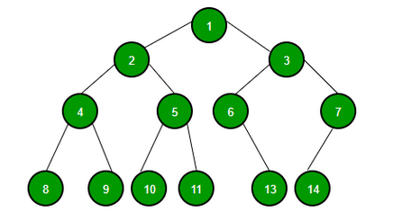
Questions
Children of 2:
No of leaves:
Parent of 6:
Level of 5:
Subtrees of 2 & 6:
Ancestors of 10:

Slide 52
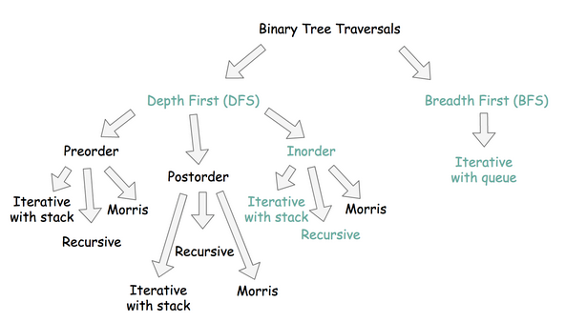

Slide 53
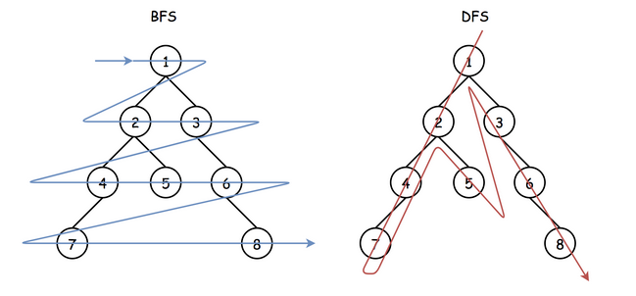

Slide 54
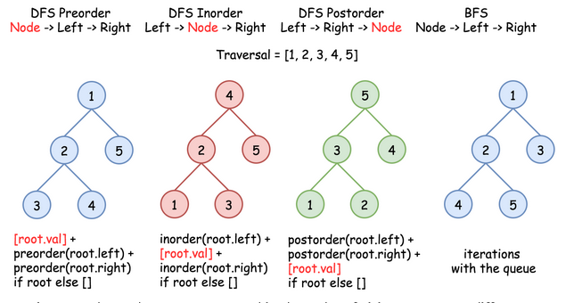

Slide 55
Traverse a Tree
DFS Pre-order Traversal: Visit ( Node→left subtree→right subtree )
DFS In-order Traversal: Visit ( left subtree→Node→right subtree )
DFS Post-order Traversal: Visit ( left subtree→right subtree→Node )

Slide 56
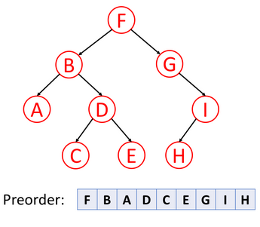
Pre-order Traversal

Slide 57
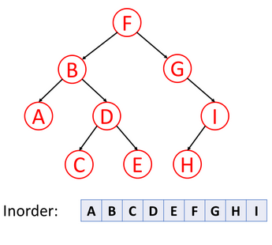
In-order Traversal

Slide 58
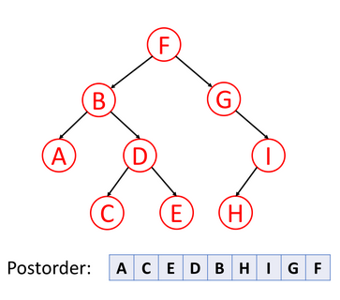
Post-order Traversal

Slide 59
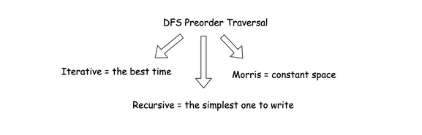

Slide 60
Complexity

Slide 61
Algorithms

Slide 62
Most Common Coding Algorithms
Brute Force Algorithm.
Recursive Algorithm.
Divide and Conquer Algorithm.
Binary Search.
Merge Sort.
Quick Sort.
Sorting Algorithm
Bubble Sort.
Insertion Sort.
Merge, Selection, Quick Sort
Dynamic Programming Algorithm.
Greedy Algorithm.
Backtracking Algorithm

Slide 63
Sorting Algorithms- Selection Sort
Selection Sort
Initialize minimum value(min_idx) to location 0
Traverse the array to find the minimum element in the array
While traversing if any element smaller than min_idx is found then swap both the values.
Then, increment min_idx to point to next element
Repeat until array is sorted

Slide 64
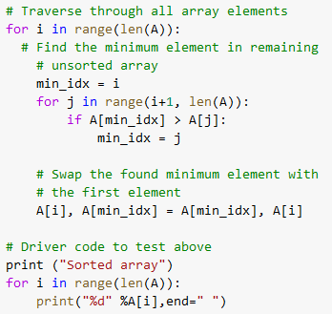
Selection Sort
Example:
A = [ 64, 25, 12, 22, 11]
First Pass: [ 11, 25, 12, 22, 64]
Second Pass: [ 11, 12, 25, 22, 64]
Third Pass: [ 11, 12, 22, 25, 64]
Fourth Pass: [ 11, 12, 22, 25, 64]
Fifth Pass: [ 11, 12, 22, 25, 64]

Slide 65
Selection Sort (Complexity)
Time Complexity: The time complexity of Selection Sort is O(N²) as there are two nested loops:
One loop to select an element of Array one by one = O(N)
Another loop to compare that element with every other Array element = O(N)
Therefore overall complexity = O(N)*O(N) = O(N*N) = O(N²)
Auxiliary Space: O(1) as the only extra memory used is for temporary variable while swapping two values in Array. The good thing about selection sort is it never makes more than O(n) swaps and can be useful when memory write is a costly operation.

Slide 66
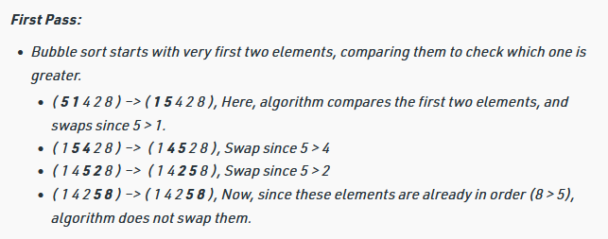
Sorting Algorithms- Bubble Sort
Bubble Sort is the simplest sorting algorithm that works by repeatedly swapping the adjacent elements if they are in the wrong order. This algorithm is not suitable for large data sets as its average and worst case time complexity is quite high.

Slide 67
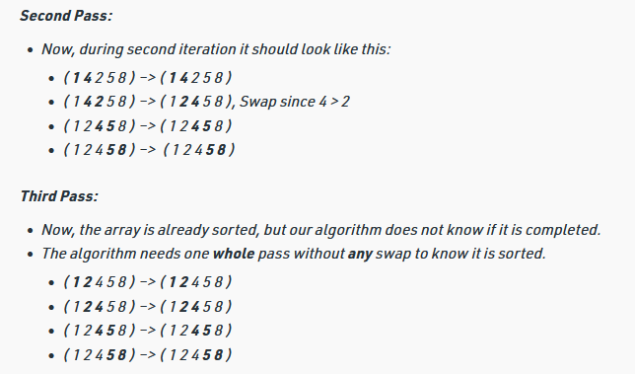

Slide 68
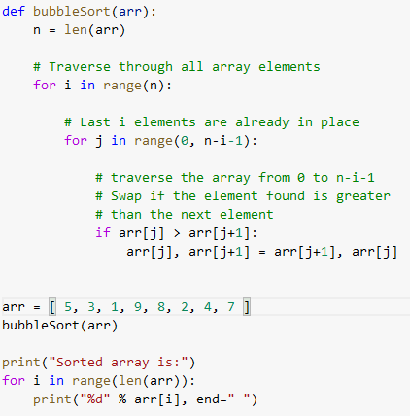
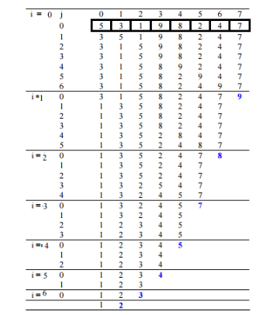
A = [ 5, 3, 1, 9, 8, 2, 4, 7 ]

Slide 69
Bubble Sort- Complexity
Time Complexity: O(N²)
Auxiliary Space: O(1)

Slide 70
Sorting Algorithm-Insertion Sort
Insertion sort is a simple sorting algorithm that works similar to the way you sort playing cards in your hands. The array is virtually split into a sorted and an unsorted part. Values from the unsorted part are picked and placed at the correct position in the sorted part.
Characteristics of Insertion Sort:
This algorithm is one of the simplest algorithm with simple implementation
Basically, Insertion sort is efficient for small data values
Insertion sort is adaptive in nature, i.e. it is appropriate for data sets which are already partially sorted.

Slide 71
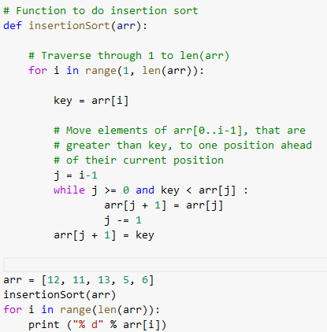
Sorting Algorithm- Insertion Sort
Example: A = [ 4, 3, 2, 10, 12, 1, 5, 6]
[ 4, 3, 2, 10, 12, 1, 5, 6] ⇒ [3, 4, 2, 10, 12, 1, 5, 6], i = 1
[3, 4, 2, 10, 12, 1, 5, 6] ⇒ [ 2, 3 , 4, 10, 12, 1, 5, 6], i = 2
[ 2, 3 , 4, 10, 12, 1, 5, 6] ⇒ [ 2, 3 , 4, 10, 12, 1, 5, 6], i = 3
[ 2, 3 , 4, 10, 12, 1, 5, 6] ⇒ [ 2, 3 , 4, 10, 12, 1, 5, 6], i = 4
[ 2, 3 , 4, 10, 12, 1, 5, 6] ⇒ [ 1, 2, 3 , 4, 10, 12, 5, 6], i = 5
[ 1, 2, 3 , 4, 10, 12, 5, 6] ⇒ [ 1, 2, 3 , 4, 5, 10, 12, 6], i = 6
[ 1, 2, 3 , 4, 5, 10, 12, 6] ⇒ [ 1, 2, 3 , 4, 5, 6, 10, 12], i = 7

Slide 72
Insertion Sort-Complexity
Time Complexity: O(N^2)
Auxiliary Space: O(1)

Slide 73
Divide & Conquer Algorithms
Divide and Conquer is an algorithmic paradigm. A typical Divide and Conquer algorithm solves a problem using following three steps.
Divide: Break the given problem into subproblems of same type.
Conquer: Recursively solve these subproblems
Combine: Appropriately combine the answers
Examples:
Binary Search
Merge Sort
Quick Sort

Slide 74
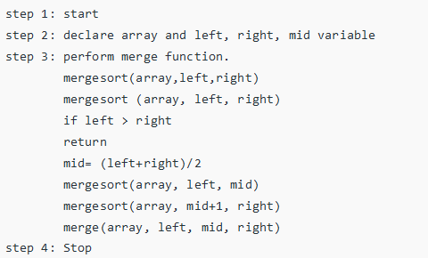
Divide & Conquer Algorithms-Merge Sort
Merge Sort is a Divide and Conquer algorithm.
It divides the input array into two halves, calls
itself for the two halves, and then it merges the
two sorted halves.
The merge() function is used for merging two halves.
The merge(arr, l, m, r) is a key process that assumes
that arr[l..m] and arr[m+1..r] are sorted and merges the
two sorted subarrays into one.

Slide 75
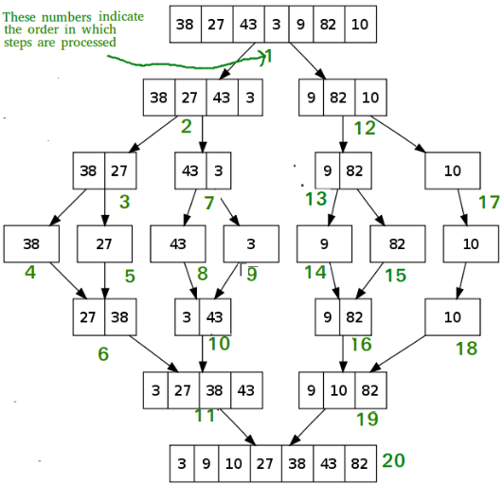
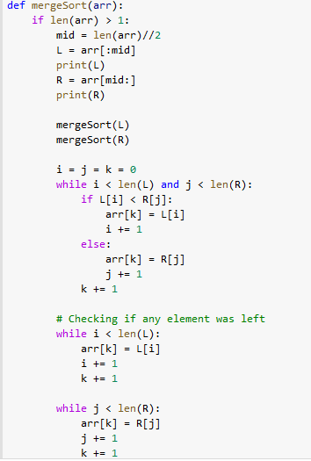

Slide 76
Merge Sort- Complexity
Time Complexity:
The time complexity of the merge sort depends upon two factors:
The list split factor which takes log(N)
The second factor merge the two list, which takes linear time, so its complexity is O(N)
Thus, the total complexity is based on the previous two factors of the merge sort is O(NlogN).

Slide 77
Divide & Conquer Algorithms-Quick Sort
QuickSort is a Divide and Conquer algorithm. It picks an element as pivot and partitions the given array around the picked pivot. There are many different versions of quickSort that pick pivot in different ways.
Always pick first element as pivot.
Always pick last element as pivot (implemented in next example)
Pick a random element as pivot.
Pick median as pivot.

Slide 78
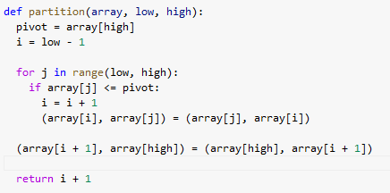
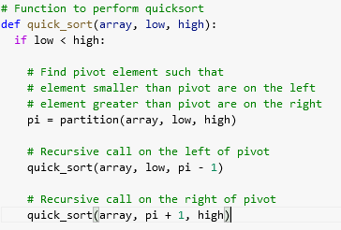
Divide & Conquer Algorithms-Quick Sort
[10, 80, 30, 90, 40, 50, 70 ] , j = 0, i = -1
⇒ [10, 80, 30, 90, 40, 50, 70 ] , j = 0, i = 0
⇒ [10, 80, 30, 90, 40, 50, 70 ] , j = 1, i = 0
⇒ [10, 80, 30, 90, 40, 50, 70 ] , j = 2, i = 1
⇒ [10, 30, 80, 90, 40, 50, 70 ] , j = 3, i = 1
⇒ [10, 30, 80, 90, 40, 50, 70 ] , j = 4, i = 2
⇒ [10, 30, 40, 90, 80, 50, 70 ] , j = 5, i = 3
⇒ [10, 30, 40, 50, 80, 90, 70 ]
[10, 30, 40, 50, 80] [ 90, 70 ]
[ 70, 90 ]

Slide 79
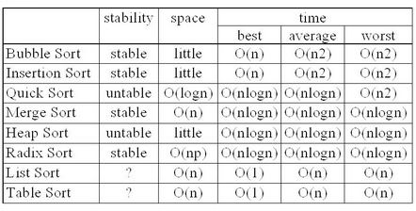
Quick Sort- Complexity
The best-case time complexity of quicksort is O(nlogn)

Slide 80
Binary Heap

Slide 81
Heap | Content
Understand the Heap data structure.
Understand Max Heap and Min Heap.
Understand the insertion and deletion of a Heap.
Implement a Heap.

Slide 82
Heap
a Heap is a special type of binary tree. A heap is a binary tree that meets the following criteria:
Is a complete binary tree;
The value of each node must be no greater than (or no less than) the value of its child nodes.
A Heap has the following properties:
Insertion of an element into the Heap has a time complexity of O(log⁡N).
Deletion of an element from the Heap has a time complexity of O(log⁡N).
The maximum/minimum value in the Heap can be obtained with O(1) time complexity.

Slide 83
Heap
There are two kinds of heaps: Max Heap and Min Heap.
Max Heap: Each node in the Heap has a value no less than its child nodes. Therefore, the top element (root node) has the largest value in the Heap.
Min Heap: Each node in the Heap has a value no larger than its child nodes. Therefore, the top element (root node) has the smallest value in the Heap.

Slide 84
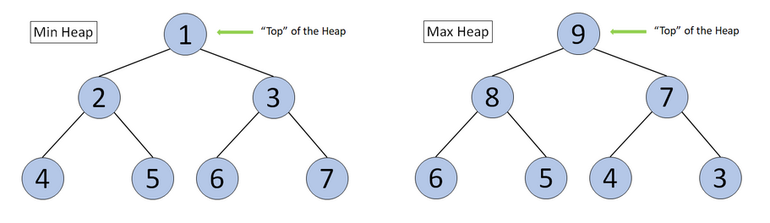
Max/Min Heap

Slide 85
Heap| Insertion
Insertion means adding an element to the Heap. After inserting the element, the properties of the Heap should remain unchanged.
https://leetcode.com/explore/learn/card/heap/643/heap/4019/

Slide 86
Heap| Deletion
Deletion means removing the “top” element from the Heap. After deleting the element, the property of Heap should remain unchanged.
https://leetcode.com/explore/learn/card/heap/643/heap/4020/

Slide 87
Implementation of Heap
We often perform insertion, deletion, and getting the top element with a Heap data structure.
We can implement a Heap using an array. Elements in the Heap can be stored in the array in the form of a binary tree. The code below will implement “Max Heap” and “Min Heap” for integers (In LeetCode problems or daily work, we often will use existing libraries instead of manually implementing Heap).

Slide 88
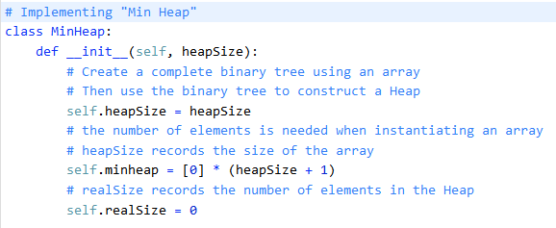

Slide 89
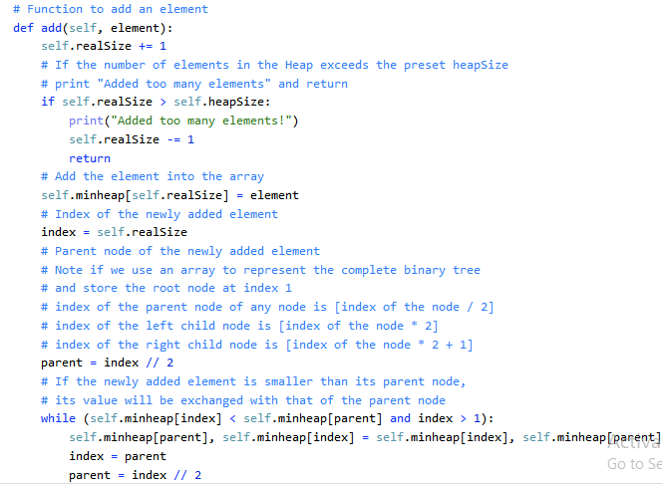

Slide 90
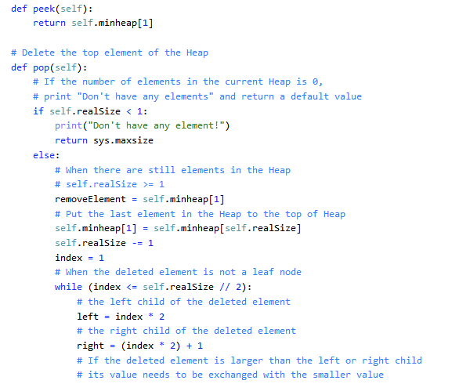

Slide 91
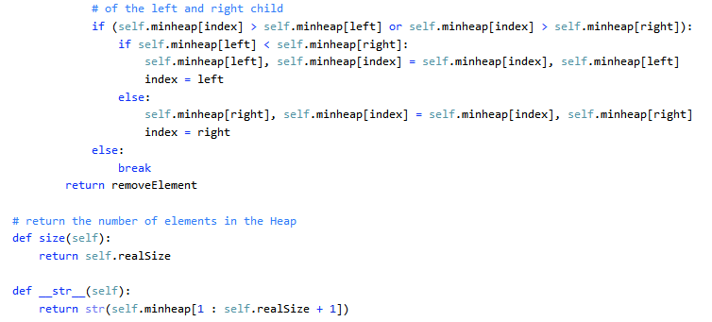

Slide 92
